Slide 1


Git & GitHub

Slide 2
Plan for the day
Introducing GitHub, Terminal commands and Git.
Make sure Git is installed and you have a GitHub account
Setting up a GitHub repository
Exercises (together):
Connecting a local folder to your repository (we will push “HTML” folder from the previous lesson)
Cloning a GitHub repository to your PC

Slide 3
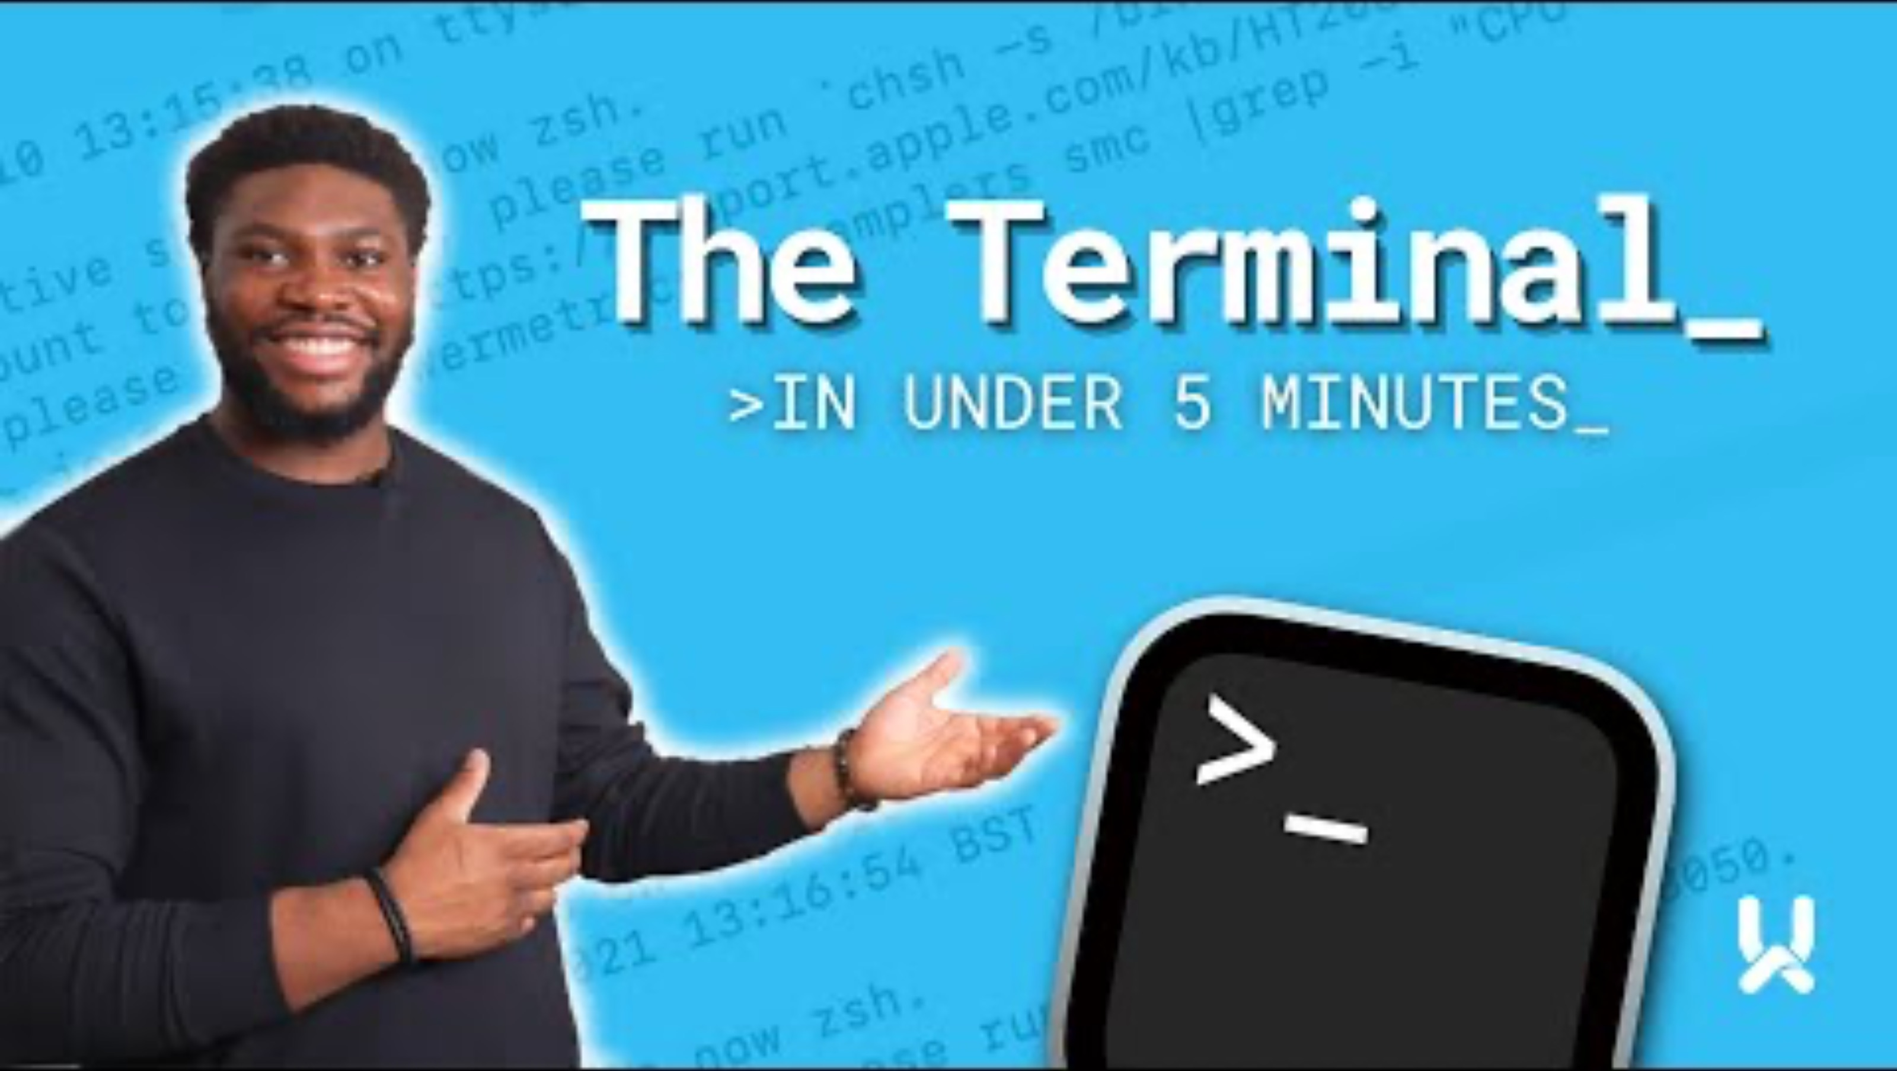
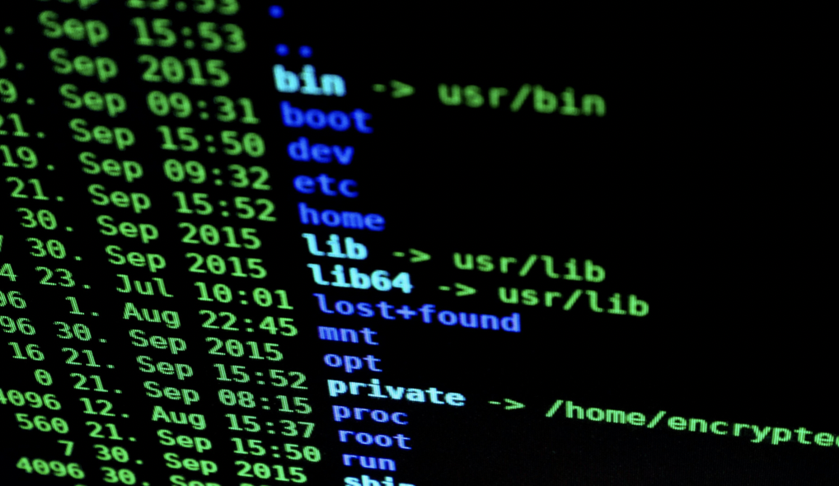
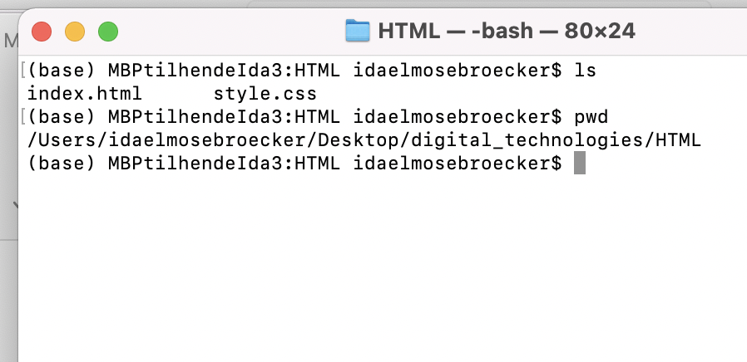
Terminal
A way to access your computer
When you see a cool hacker movie with a lot of this:
WHY?
Important when using GitHub and Git.
Fast alternative to drag-and-drop
GitHub is very popular in most workplaces with developers.
Types:
Shells:
Bash.
Cmd.
PowerShell.

Slide 4


Git
Version control system
Allows to go back in time to previous versions
Nothing is ever lost, if it’s committed to Git
When could it be beneficial for you??

Slide 5
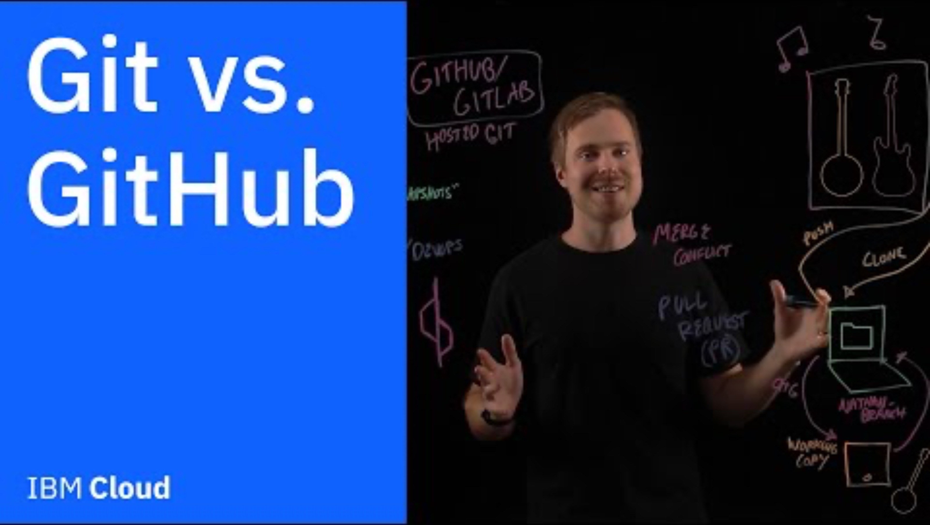
GitHub:
Online host for Git
Provides a nice interface for looking at your files and projects
Platform for searching for similar or just interesting projects
Enables:
- Collaboration across computers
- Project sharing
- Open source sharing
Used in increasingly many workplaces !

Slide 6
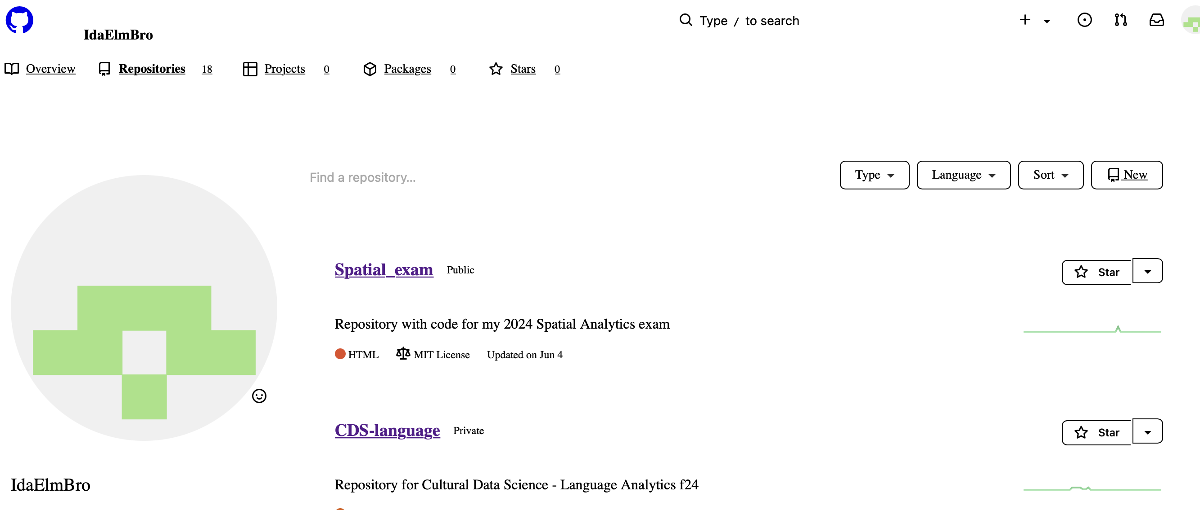
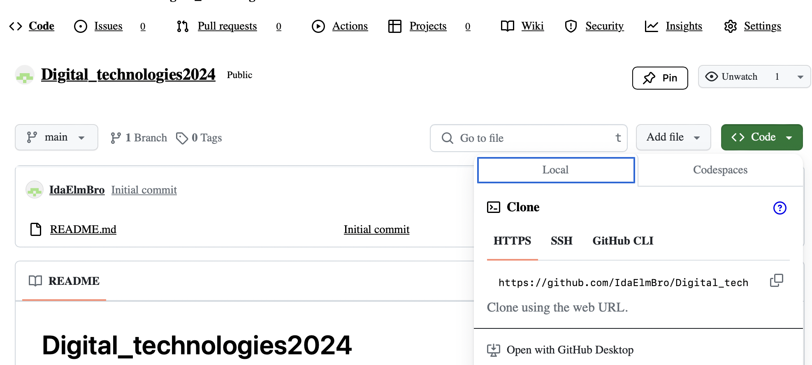
Overview of GitHub
Repository URL

Slide 7
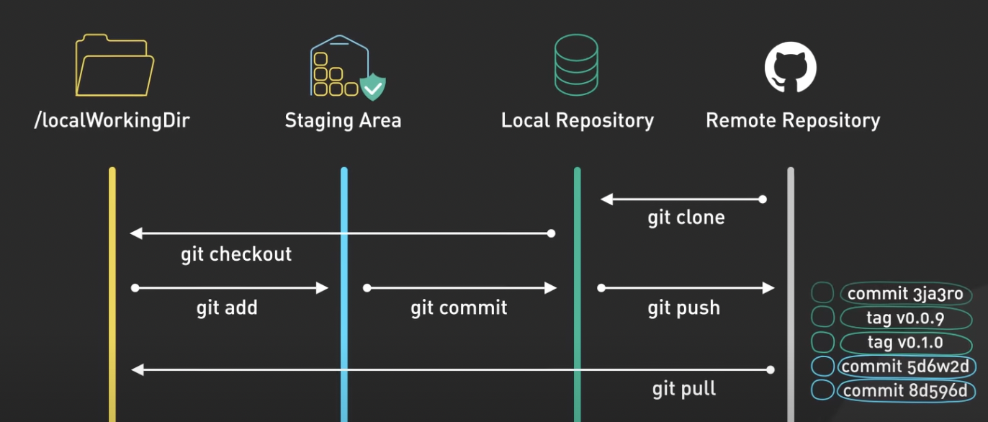
How it works:
Git and GitHub terms:
Forking = a GitHub (independent) copy of a repo
Cloning = a local (and linked) copy of a repo
Add = place it in the staging area (ready to be saved)
Commit = checkpoint (a save)
Push to GitHub = get local changes to GitHub
Pull from GitHub = get changes on GitHub to your local folder

Slide 8


Together!
do it together.
Tools that keeps track of previous work
- version control
Allows for cooperation on scripts at the same time.
And also a nice “online backup”!!
Nice to have on your CV :-D
It can take a long time to get familiar with, but when you do, it can be a real lifesaver!
Let’s try and do it together

Slide 9

Questions:
What is a repository?
What is a working directory?
What is the difference between Git and GitHub?
What is a Terminal?
How do you save changes via Git? (specific commands)
What is the difference between pushing to and pulling from GitHub?

Slide 10
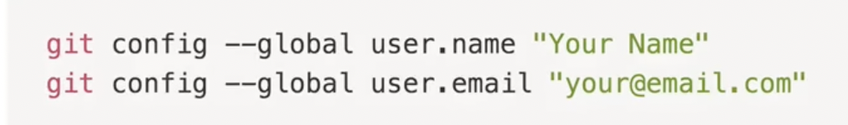
Checklist:
How far are you?
Install Git
Make a GitHub account
Make a repository
IS git configured?? If not run these in the command line:

Slide 11
Exercise 1 - add a local folder to GitHub
Connecting a local folder to your repository (we will push “HTML” folder from the previous lesson)
Steps:
Make sure you have a folder on your PC called “HTML”
Make an empty repository on GitHub called HTML or Digital Technologies or whatever you want
Open the terminal and navigate to the right directory (HTML folder)
Push it using commands in the terminal

Slide 12
Let’s do it together!
Connect local folder to remote GitHub repository
Steps:
Create a new repository on GitHub.
Open the Terminal.
Change the current working directory to your local project.
Connect via terminal

Slide 13
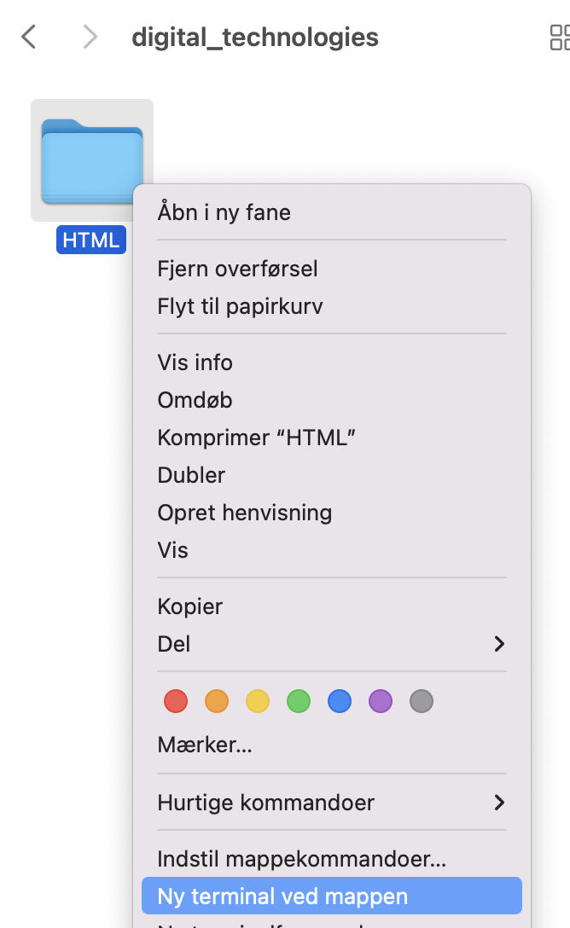
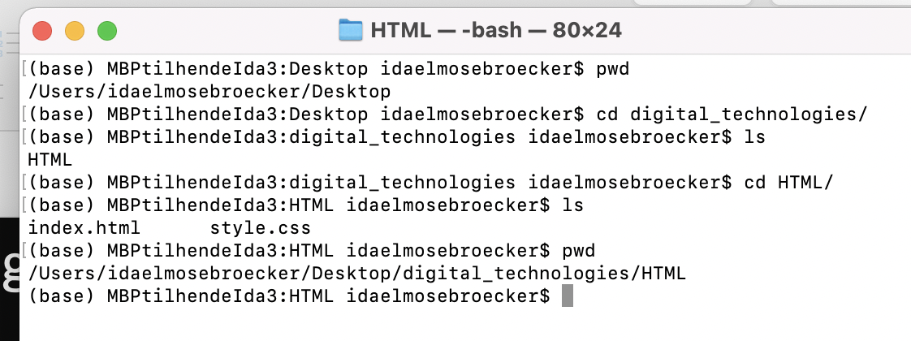
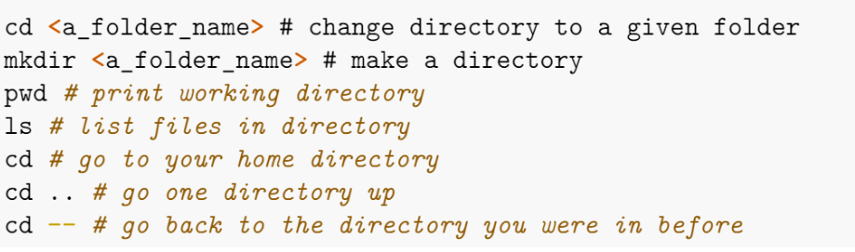
Navigate to right directory
We must open our terminal and navigate to the right folder. Can be done 2 ways.
Using the right click method.
Using the terminal.
How to use the terminal: (commands)

Slide 14
Now: TERMINAL!

Slide 15
1. Initialize the local directory as a Git repository: $ git init 2. Add the files in your new local repository. This stages them for the first commit: $ git add . 3. Commit the files that you've staged in your local repository. $ git commit -m "First commit" 4. At the top of your GitHub repository's Quick Setup page, click to copy the remote repository URL. 5. In the Command prompt, add the URL for the remote repository where your local repository will be pushed. $ git remote add origin <remote repository URL> # Sets the new remote 6. Push the changes in your local repository to GitHub if there is a remote branch called main $ git push origin main /master (du skal bruge master) ! Now you can see the files from your local folder on GitHub !
HOW!!???
Workflow
git init
$ git add .
$ git commit -m "First commit"
$ git remote add origin <remote repository URL>
$ git push origin main

Slide 16

Exercise 2 - clone a repository from GitHub to your PC )
Now we want a repository from GitHub to appear locally, on your computer
Steps:
Terminal is in the desired location, were you want a local version of our GitHub repository.
Find an exciting repository ( or use mine: https://github.com/IdaElmBro/Digital_technologies2024)
Fork the repository to your own GitHub
Clone the repository:
This will create a local folder from the cloned repository

Slide 17
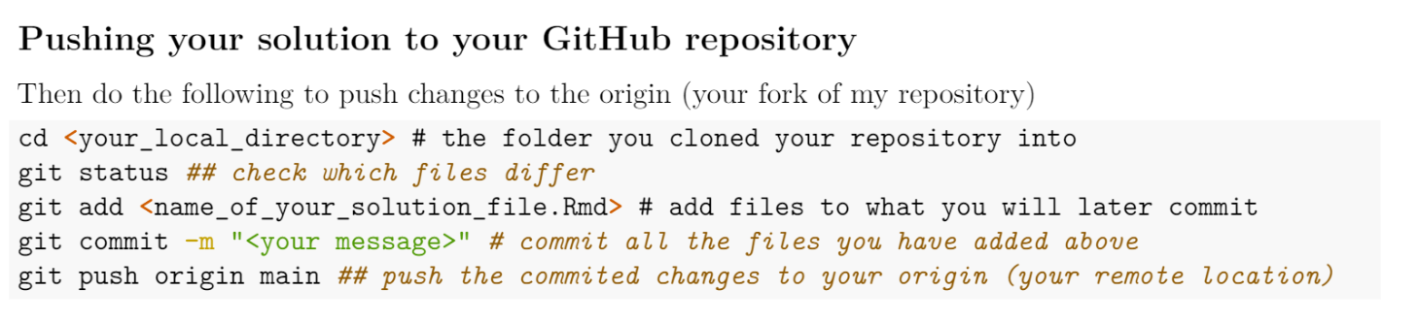
Version Control
If there’s more time, play around with changing the files on your computer and them pushing (uploading) them to GitHub

